Slide 1


New York City Taxi Trip Duration
By Nurul Syakirah Ahmad Ghazali from AGP 12

Slide 2
Table of contents
01
02
03
04
Taxi Dataset
Data Analysis
Data cleaning and feature engineering
Exploratory Data Analysis (EDA) and visualisations
ML Models
Best Model
Choosing the best ML models for prediction
The finalised model and its results

Slide 3
01
Taxi Dataset
Data cleaning and feature engineering

Slide 4
id - a unique identifier for each trip
vendor_id - a code indicating the provider associated with the trip record
pickup_datetime - date and time when the meter was engaged
dropoff_datetime* - date and time when the meter was disengaged
passenger_count - the number of passengers in the vehicle (driver entered value)
pickup_longitude - the longitude where the meter was engaged
pickup_latitude - the latitude where the meter was engaged
dropoff_longitude - the longitude where the meter was disengaged
dropoff_latitude - the latitude where the meter was disengaged
store_and_fwd_flag - This flag indicates whether the trip record was held in vehicle memory before sending to the vendor because the vehicle did not have a connection to the server - Y=store and forward; N=not a store and forward trip
trip_duration* - duration of the trip in seconds
Train dataset :
1458644 rows, 11 columns
Test dataset :
625134 rows, 9 columns*
No missing values and duplicates
OBJECTIVE:
Predict the trip duration of a taxi ride

Slide 5
Train set summary
 | vendor_id | passenger_count | pickup_longitude | pickup_latitude | dropoff_longitude | dropoff_latitude | trip_duration
count | 1.458644e+06 | 1.458644e+06 | 1.458644e+06 | 1.458644e+06 | 1.458644e+06 | 1.458644e+06 | 1.458644e+06
mean | 1.534950e+00 | 1.664530e+00 | -7.397349e+01 | 4.075092e+01 | -7.397342e+01 | 4.075180e+01 | 9.594923e+02
std | 4.987772e-01 | 1.314242e+00 | 7.090186e-02 | 3.288119e-02 | 7.064327e-02 | 3.589056e-02 | 5.237432e+03
min | 1.000000e+00 | 0.000000e+00 | -1.219333e+02 | 3.435970e+01 | -1.219333e+02 | 3.218114e+01 | 1.000000e+00
25% | 1.000000e+00 | 1.000000e+00 | -7.399187e+01 | 4.073735e+01 | -7.399133e+01 | 4.073588e+01 | 3.970000e+02
50% | 2.000000e+00 | 1.000000e+00 | -7.398174e+01 | 4.075410e+01 | -7.397975e+01 | 4.075452e+01 | 6.620000e+02
75% | 2.000000e+00 | 2.000000e+00 | -7.396733e+01 | 4.076836e+01 | -7.396301e+01 | 4.076981e+01 | 1.075000e+03
max | 2.000000e+00 | 9.000000e+00 | -6.133553e+01 | 5.188108e+01 | -6.133553e+01 | 4.392103e+01 | 3.526282e+06
Possible outliers:
passenger_count : min value of 0, max value of 9
trip_duration : minimum value of 1 second

Slide 6
Feature Engineering
pickup time
weekend
trip distance
extract day, month, hour and minute from pickup_datetime
1 if on weekends, 0 otherwise
spherical distance with geopy great circle in km
holiday
time of day
weather
data: NYC_2016Holidays
Yes if on holiday day,
Close if holiday day +- 1,
No otherwise
Morning : 6am-12pm
Afternoon : 12pm-4pm
Evening : 4pm-10pm
Late : 10pm-6am
data: KNYC_Metars
Extract Events column for the respective pickup_datetime

Slide 7
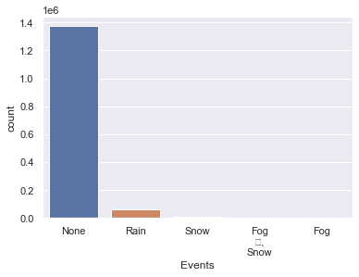
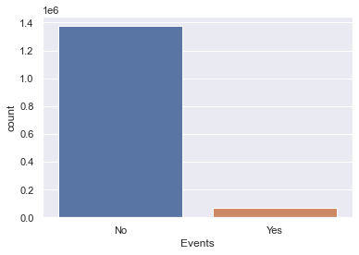
Transformation: weather
Before
After
The values for Rain, Snow, Fog&Snow, Fog categories are too small
This will cause sparse vectors – most of them are zeroes
Combine Rain, Snow, Fog&Snow, Fog categories together to Yes

Slide 8
02
Data Analysis
Exploratory Data Analysis (EDA) and visualisations

Slide 9
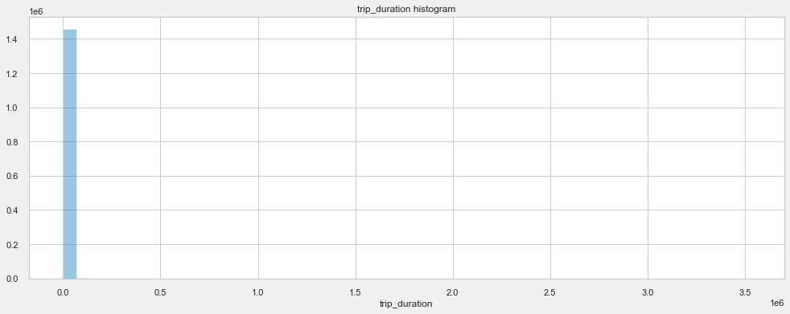
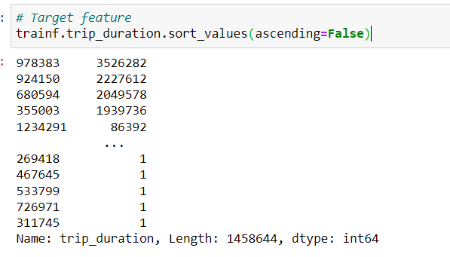
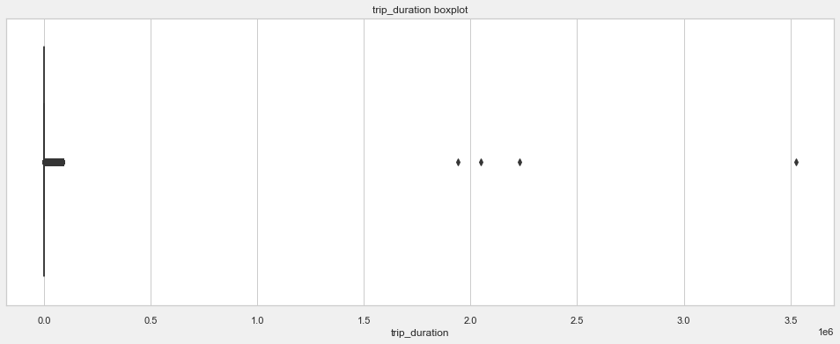
Univariate: trip_duration (target)
OUTLIERS
There are outliers for the target feature.
Possible reasons are wrong entry from taxi driver, cancelled rides and system failure.

Slide 10
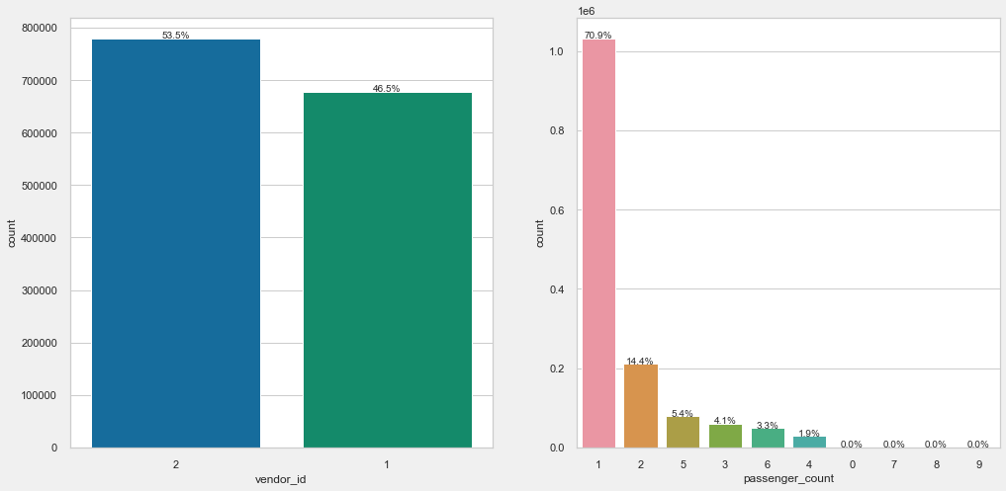
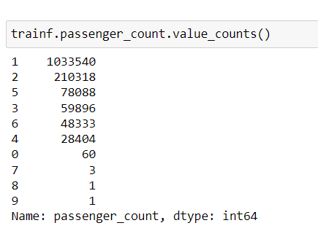
Univariate: vendor_id, passenger_count
Vendor 2 has slightly more trips, but they are similar in distribution.
Most of the time, there's 1 passenger in a ride. However, there are 60 rides with 0 passenger which indicates outliers caused by errors.

Slide 11
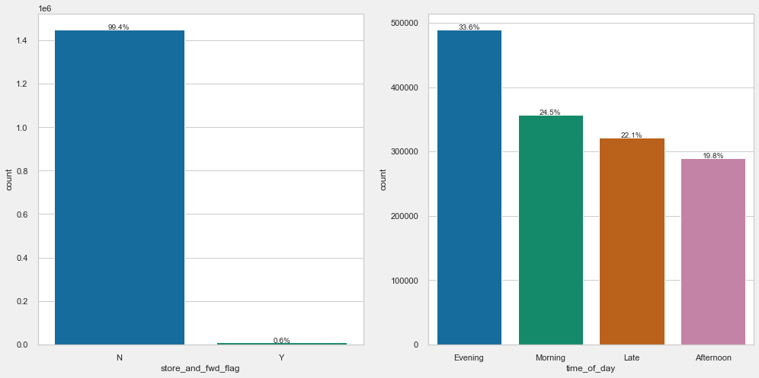
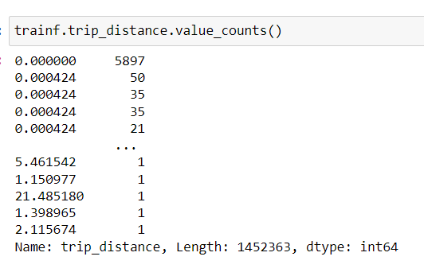
Univariate: store_and_fwd_flag, trip_distance
Less than 1% of rides were stored before being forwarded to the system.
For 0 km distance outliers, either cancelled trips/system error/gps not available

Slide 12
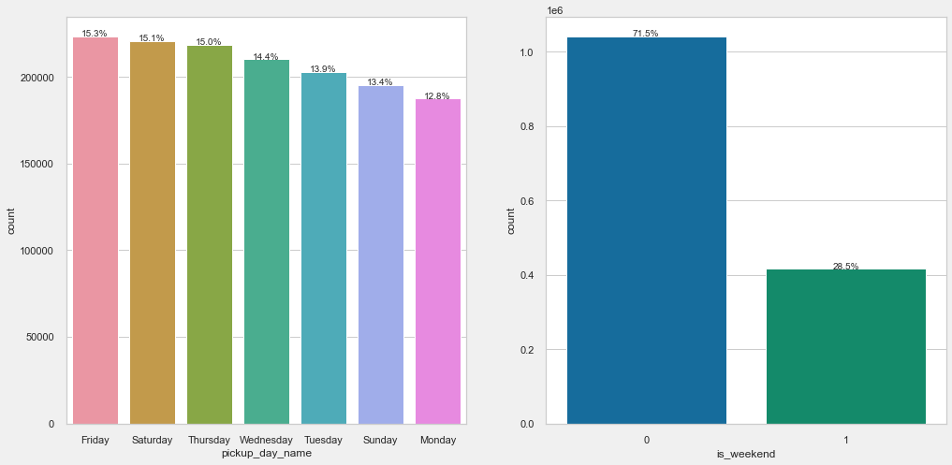
Univariate: pickup_day_name, is_weekend
Friday is the busiest day, followed by Saturday. Friday is the last working day, so people are returning to their hometown.

Slide 13
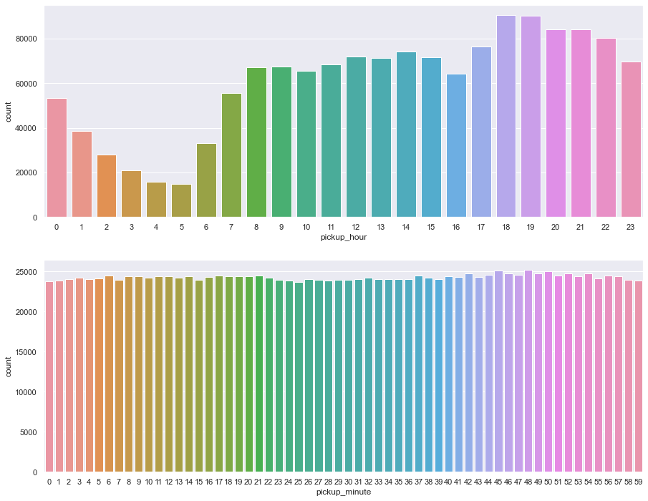
Univariate: pickup_hour, time_of_day
The peak hour for trips are during the end of working hours (6pm-7pm).
Evening (work ends) has the most trips, followed by morning (work starts).

Slide 14
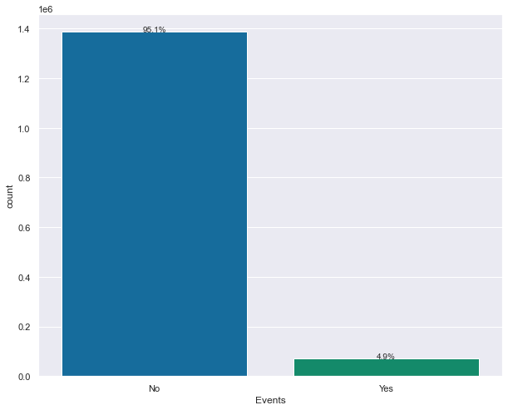
Univariate: Events
NYC weather are normal from January 2016 to June 2016 most of the time.

Slide 15
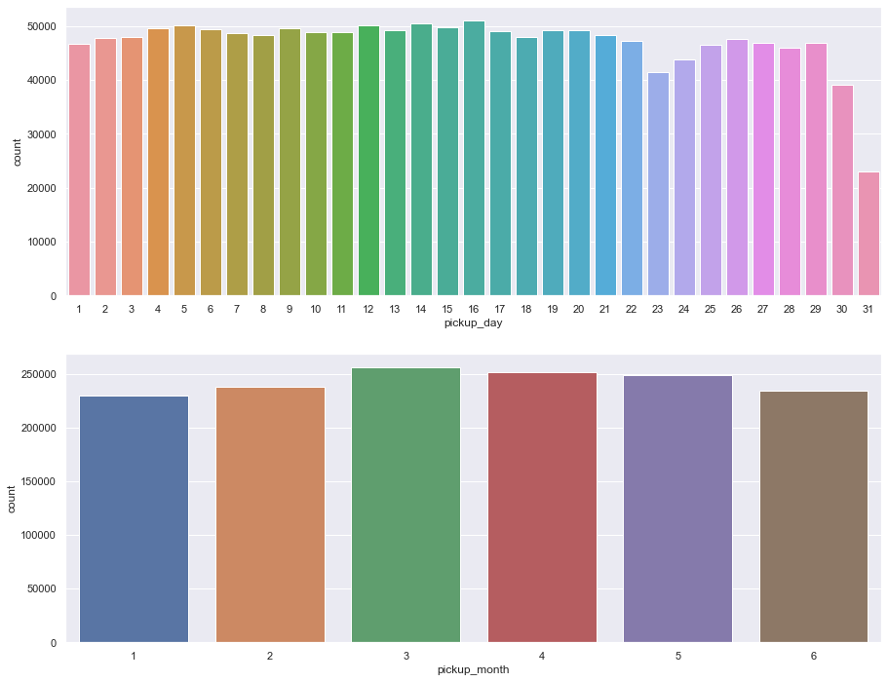
Univariate: pickup_month, pickup_day, pickup_minute
There are no obvious patterns observed from these 3 features.

Slide 16
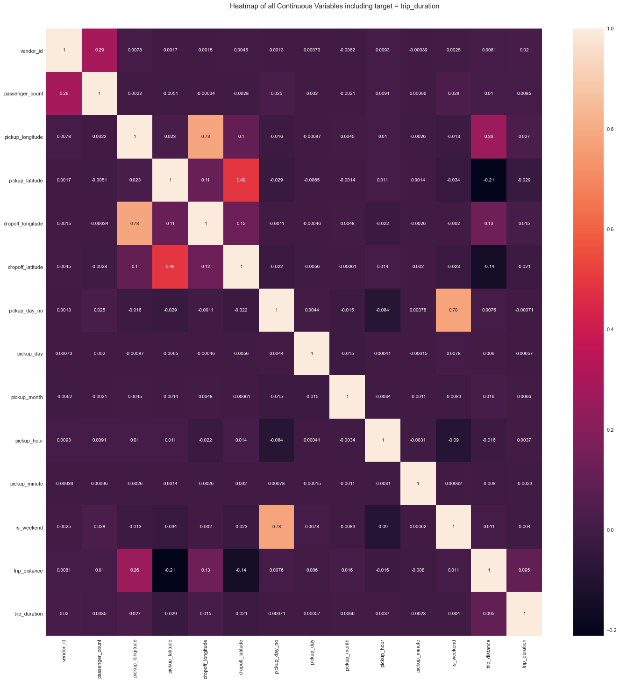
Correlation Heatmap

Slide 17
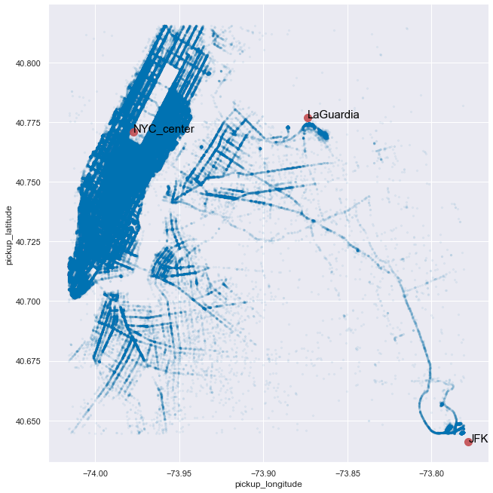
Correlation Heatmap
The pickup points are centered at 3 main location:
NYC Center, LaGuardia Airport, JFK Airport

Slide 18
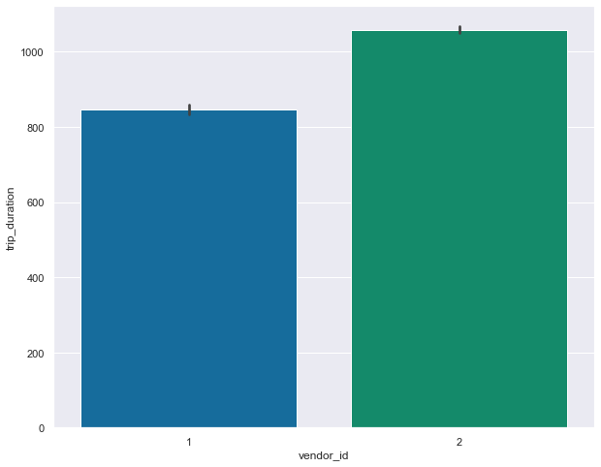
trip_duration vs vendor_id
Vendor 2 have longer rides than Vendor 1.

Slide 19
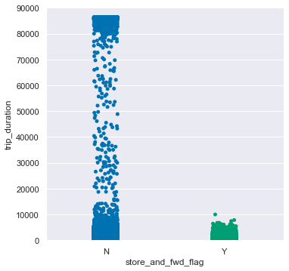
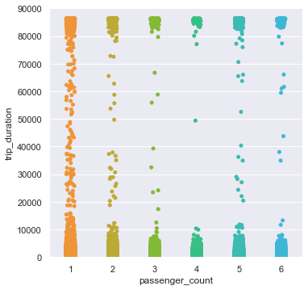
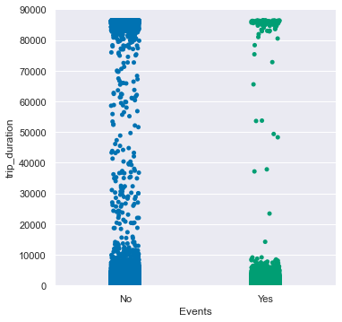
trip_duration vs passenger_count, stor_and_fwd_flag, Events
Longer trip are less prone to store their trips.
There are no clear correlation between trip_duration and passenger_count, Events.

Slide 20
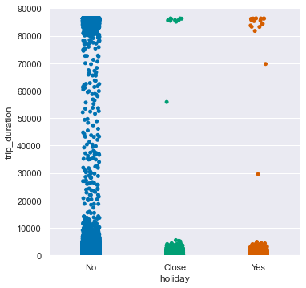
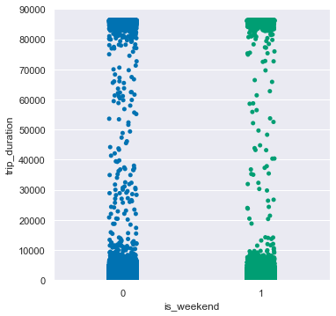
trip_duration vs holiday, time_of_day, is_weekend
There are no clear correlation between these features.

Slide 21
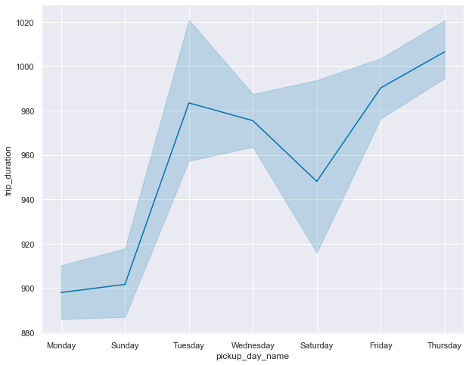
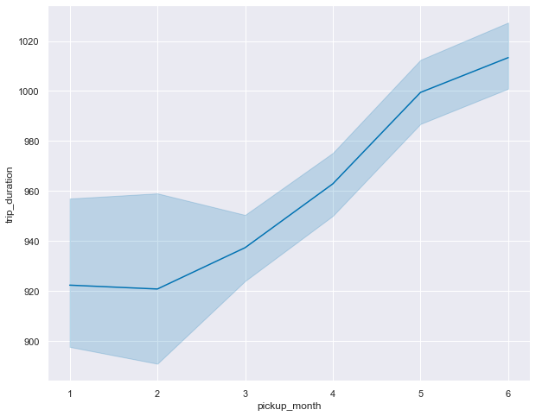
trip_duration vs pickup_day_name, pickup_month
Thursdays have longest taxi trips, then Fridays.
The trip durations steadily increases starting February 2016.

Slide 22
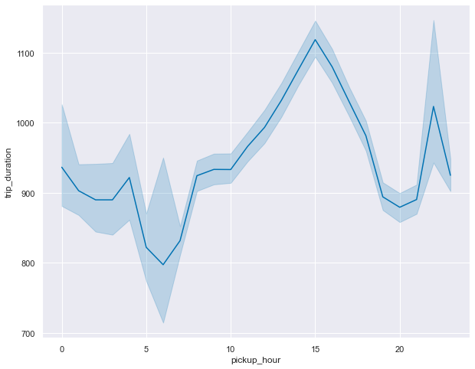
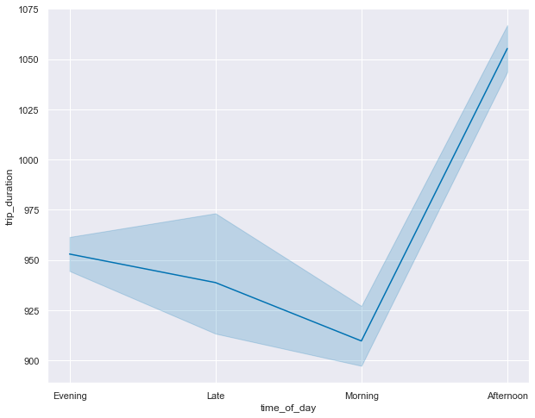
trip_duration vs pickup_hour, time_of_day
The traffic is the busiest at 3pm (afternoon) and empty at 6am (late night/morning).

Slide 23
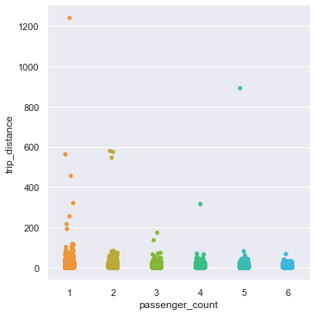
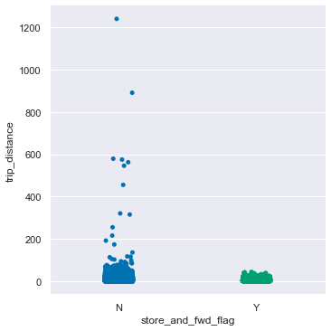
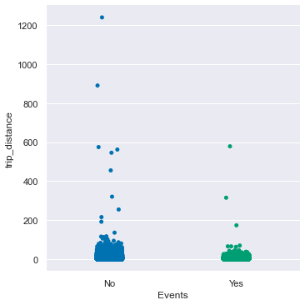
trip_distance vs passenger_count, stor_and_fwd_flag, Events
Lone passenger tends to take a longer trip distance.
Longer trip distance are prone for the data not being stored.
When the weather’s normal, passengers take a longer trip distance.

Slide 24
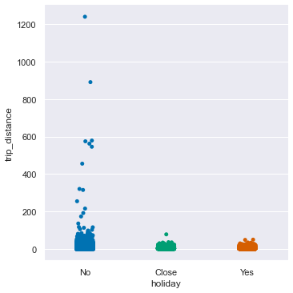
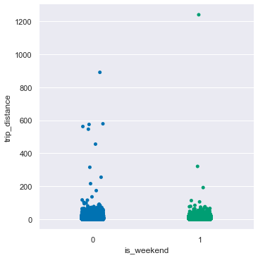
trip_distance vs holiday, is_weekend
During holidays, passengers travel to closer locations.
Most passengers take shorter trips during weekends.

Slide 25
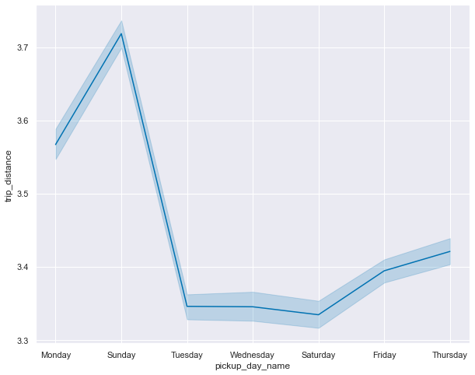
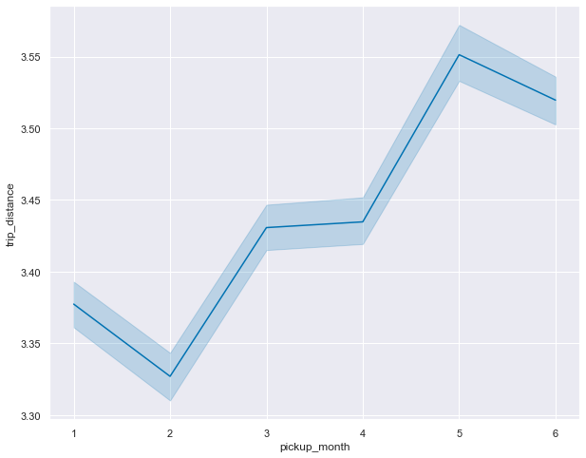
trip_distance vs pickup_day_name, pickup_month
Mondays and Sundays have longer trip distances, probably traveling to airport for work.
pickup_month have similar pattern to trip_duration.

Slide 26
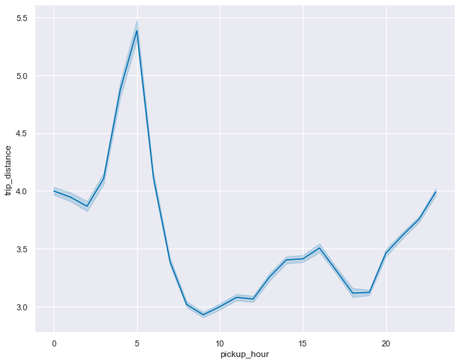
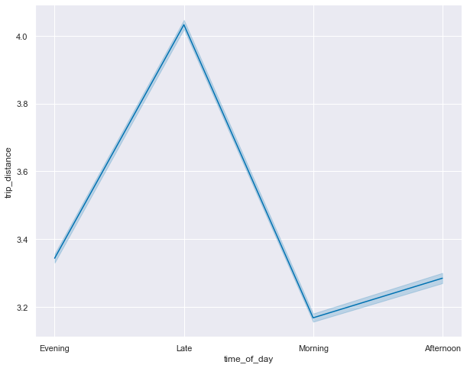
trip_distance vs pickup_hour, time_of_day
Both of them have similar curves, with travel distance peaked during 6am (late night/early morning). Passengers may be traveling to the airport as cheaper flights are usually earlier.

Slide 27
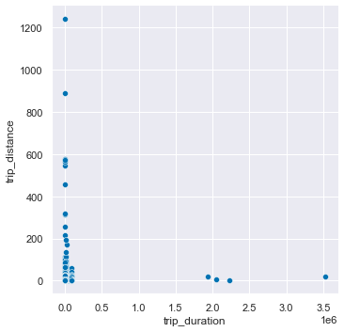
trip_distance vs trip_duration
Some datapoints have 0 distance with large duration, and vice versa.

Slide 28
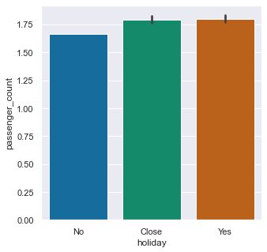
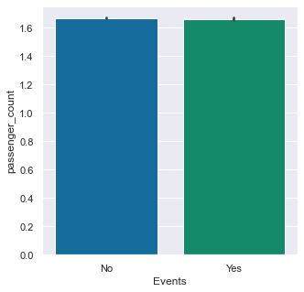
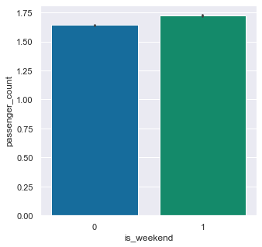
passenger_count vs holiday, Events, is_weekend
More passengers in a trip during holidays and days before/after them.
Weekends also observe more passengers per trip.
No clear correlation for Events.

Slide 29
03
ML Models
Choosing the best ML models for prediction

Slide 30
Baseline Models Removing columns & feature transformation
Split train dataset to X (features) and y (target)
Remove redundant columns in X and test dataset :
['trip_duration', 'pickup_datetime', 'pickup_day_name’]
These columns values can be derived from other features
Convert categorical features to dummy/indicator with get_dummies()
Before transformation : X and test have 17 columns
After transformation : X and test have 20 columns

Slide 31
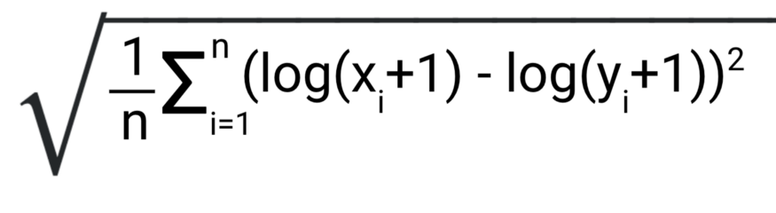
Baseline Models Evaluation Metric : Root Mean Squared Log Error (RMSLE)
where :
X = predicted value,
Y = actual value
RMSLE =
RMSLE is not sensitive to outliers, compared to RMSE
RMSLE metric only considers the relative error between and the predicted and the actual value and the scale of the error is not significant
RMSLE incurs a larger penalty for the underestimation of the actual variable than the overestimation
https://medium.com/analytics-vidhya/root-mean-square-log-error-rmse-vs-rmlse-935c6cc1802a

Slide 32
Baseline Models Models with default parameters
model | r2_train | r2_test | rmse_train | rmse_test | rmsle_train | rmsle_test
XGB | 0.0035 | 0.0109 | 5736.3268 | 3247.4845 | 0.5223 | 0.5243
Decision Tree | 1.0000 | -9.6529 | 0.0000 | 10657.6273 | 0.0000 | 0.5955
Polynomial Linear | 0.0104 | 0.0299 | 5716.2603 | 3216.1390 | 0.6201 | 0.6207
Polynomial Ridge | 0.0103 | 0.0276 | 5716.5329 | 3220.0357 | 0.6225 | 0.6232
Polynomial Lasso | 0.0099 | 0.0292 | 5717.8931 | 3217.2993 | 0.6322 | 0.6329
Polynomial ElasticNet | 0.0097 | 0.0290 | 5718.3272 | 3217.6819 | 0.6378 | 0.6386
Linear Regression | 0.0080 | 0.0263 | 5723.4164 | 3222.0308 | 0.6844 | 0.6848
MLP | -0.0279 | -0.0865 | 5825.9579 | 3403.6830 | 6.5157 | 6.5158
OVERFIT

Slide 33
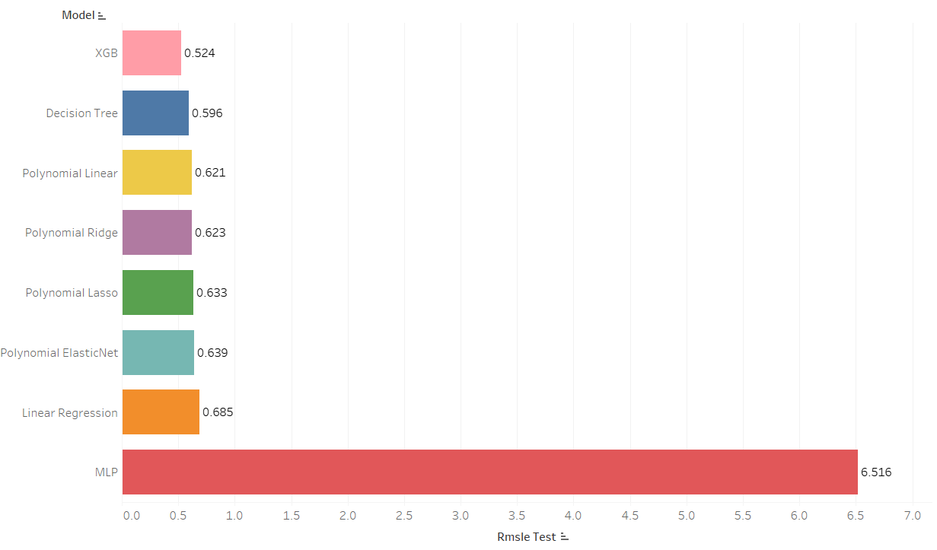
Baseline Models rmsle_test model comparisons

Slide 34
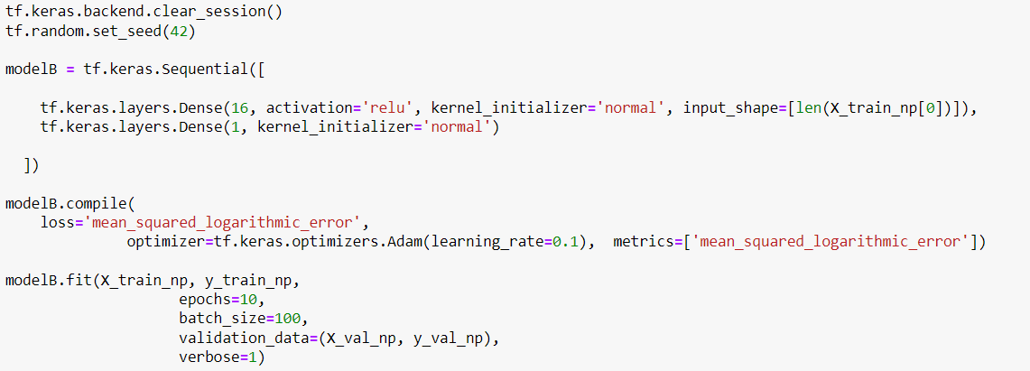
Baseline Models Multi Layer Perceptron model layers

Slide 35
Baseline Models XGBoost Parameters based on a published paper
Parameters used:
max_depth = 6
learning_rate = 0.09
n_estimators = 250
Authors’ claims:
Train set : RMSLE = 0.39
Validation set : RMSLE = 0.44
Obtained results:
Train set : RMSLE = 0.52
Validation set : RMSLE = 0.52
https://link.springer.com/content/pdf/10.1007/s13198-021-01130-x.pdf
Explanations:
Different feature engineering and transformations
Different external datasets
Different random seed

Slide 36
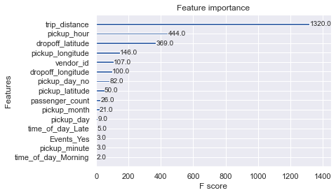
Baseline Models XGBoost Feature Importance

Slide 37
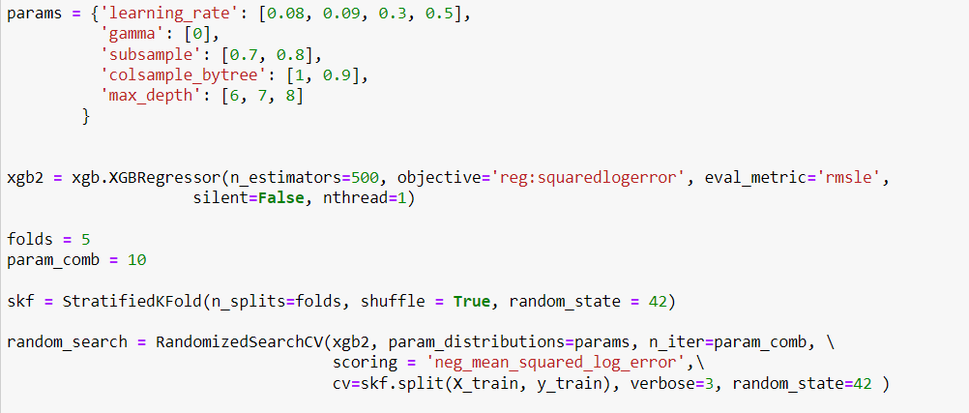
Hyperparameter Tuning RandomizedSearchCV
Improvement suggestions:
lower learning_rate
larger max_depth
larger n_iter, folds
more hyperparameters iterations

Slide 38
Hyperparameter Tuning RandomizedSearchCV cv_results_ transpose
 | 0 | 1 | 2 | 3 | 4
mean_fit_time | 290.39625 | 302.478503 | 266.692399 | 323.299799 | 263.520672
std_fit_time | 5.322445 | 7.513974 | 2.674572 | 5.733411 | 2.126646
mean_score_time | 0.871198 | 1.056328 | 0.688352 | 1.30369 | 0.685153
std_score_time | 0.029583 | 0.037458 | 0.009478 | 0.027605 | 0.011647
param_subsample | 0.8 | 0.7 | 0.7 | 0.8 | 0.7
param_max_depth | 7 | 8 | 7 | 6 | 6
param_learning_rate | 0.08 | 0.3 | 0.08 | 0.5 | 0.08
param_gamma | 0 | 0 | 0 | 0 | 0
param_colsample_bytree | 0.9 | 0.9 | 0.9 | 0.9 | 0.9
params | {'subsample': 0.8, 'max_depth': 7, 'learning_r... | {'subsample': 0.7, 'max_depth': 8, 'learning_r... | {'subsample': 0.7, 'max_depth': 7, 'learning_r... | {'subsample': 0.8, 'max_depth': 6, 'learning_r... | {'subsample': 0.7, 'max_depth': 6, 'learning_r...
split0_test_score | NaN | NaN | NaN | NaN | NaN
split1_test_score | -0.294855 | NaN | -0.311086 | NaN | -0.310963
split2_test_score | NaN | NaN | -0.311706 | NaN | -0.311474
split3_test_score | -0.294053 | NaN | NaN | NaN | -0.312857
split4_test_score | -0.296898 | NaN | -0.313479 | NaN | -0.313692
mean_test_score | NaN | NaN | NaN | NaN | NaN
std_test_score | NaN | NaN | NaN | NaN | NaN
rank_test_score | 2 | 3 | 4 | 5 | 6

Slide 39
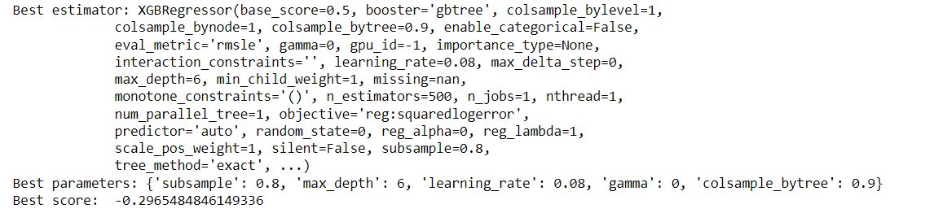
Hyperparameter Tuning XGBoost Hyperparameters
Best parameters
learning_rate : 0.08
subsample : 0.8
colsample_bytree : 0.9
max_depth : 6

Slide 40
Hyperparameter Tuning Evaluation Scores Comparison
scores | default | randomizedsearchcv
r2_train | 0.0035 | 0.0034
rmse_train | 5763.327 | 5736.559
rmsle_train | 0 | 0.5247
r2_test | 0.0109 | 0.0105
rmse_test | 3247.485 | 3248.094
rmsle_test | 0.5243 | 0.5269
The default model has a slightly better performance than the one from RandomizedSearchCV
I was tuning the wrong hyperparameters!
… after hours and hours of waiting ☹

Slide 41
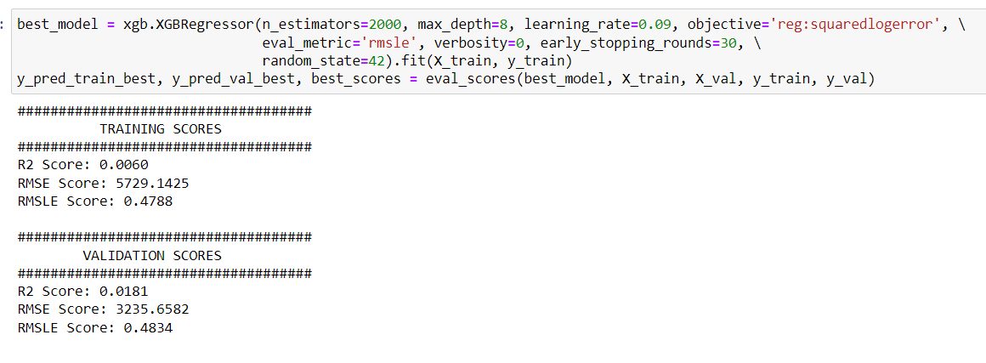

Hyperparameter Tuning Starting Over
Rerun the default model
Instead of RandomizedSearchCV, manually change hyperparameters one by one
Findings: Increasing n_estimators and max_depth minimizes RMSLE
Better performance than default model!

Slide 42
04
Final Model
The finalised model and its results

Slide 43
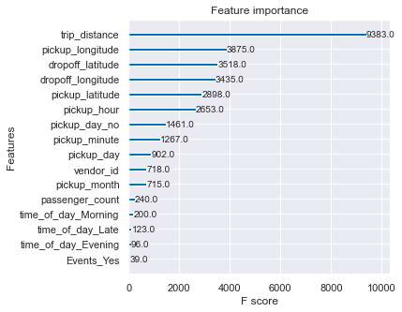
Final Model Final XGBoost Feature Importance

Slide 44
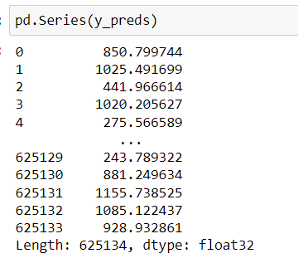
Final Model
Fit the model to the whole train.csv
Predict for test.csv
Improvements for the future:
learn more efficient ways to do hyperparameter tuning
try removing outliers to see if they affect RMSLE performance

